Slide 1


Spring MVC

Slide 2
Content
HTTP Servlet (Review)
What is Spring MVC?
MVC Architecture
Request Processing Workflow in Spring MVC
Spring Web Application Context
Spring MVC Configuration
Important Annotations
Summary

Slide 3
HTTP Servlet (Review)

Slide 4
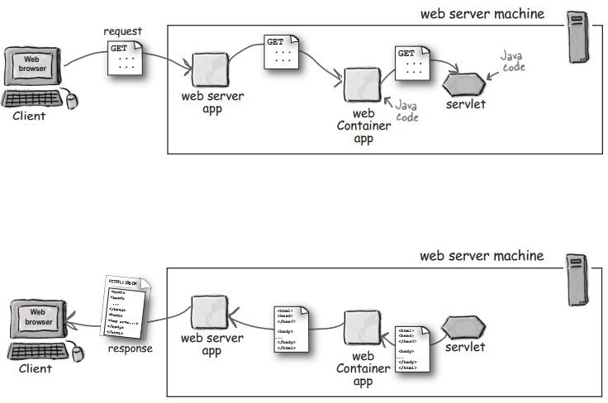

HTTP Servlets
Are Java classes that run on Web Servers to dynamically process HTTP requests and construct HTTP responses.
Deployed inside a Servlet Container which run on a Web Server.
Tomcat is a popular Servlet Container.

Slide 5
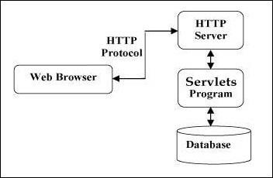
Servlets Architecture
Servlets act as a middle layer between a Web browser and databases or applications on the Web Server.
The following diagram shows the position of Servlets in a Web Application

Slide 6
What is Spring MVC ?

Slide 7
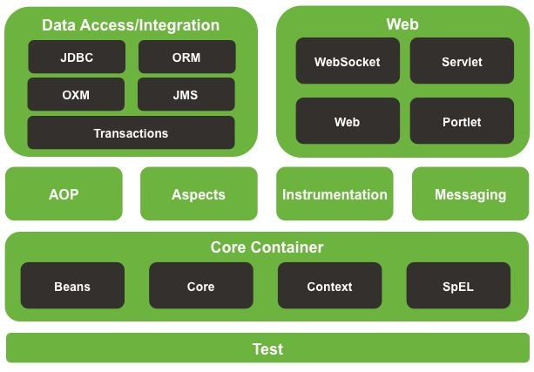
What is Spring MVC?
Modules of Spring Framework on the Web layer:
Web module provides basic web-oriented integration features and the initialization of the IoC container using servlet listeners and a web application context.
Servlet module contains Spring MVC implementation for web applications.

Slide 8
What is Spring MVC ? (cont.)
A web framework built on the Servlet API.
Provides Model-View-Controller (MVC) architecture and ready components that can be used to develop flexible and loosely coupled web applications.
Request-driven, designed around a central Servlet that dispatches requests to controllers - the DispatcherServlet.

Slide 9
MVC

Slide 10

MVC (Model-View-Controller)
Introduced by Trygve Reenskaug at Xerox Parc in 1979.

Slide 11
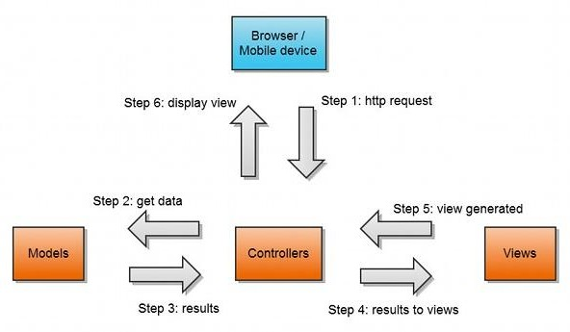
MVC (Model-View-Controller)
An architectural pattern commonly used for developing user interfaces.
An application is divided into 3 interconnected parts:
Model - Responsible for managing data of the application.
View - Responsible for displaying the model data to user.
Controller - Responsible for processing user requests and building an appropriate model and passes it to the view for rendering.

Slide 12
Request Processing Workflow in Spring MVC

Slide 13
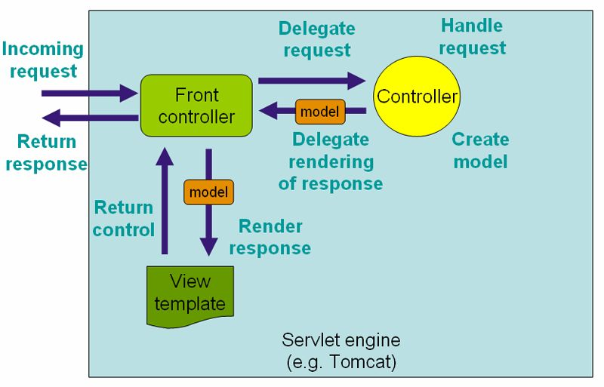
Request Processing Workflow (High Level)
The request processing workflow in Spring Web MVC (high level)

Slide 14
DispatcherServlet
Spring MVC is designed around a central servlet named DispatcherServlet.
DispatcherServlet acts as a central entry point to the Spring MVC application.
Every request is handled by DispatcherServlet.
DispatcherServlet is an expression of the Front Controller pattern.
The request processing workflow in Spring Web MVC (high level)

Slide 15
Controllers
The Front Controller’s job is to determine a suitable handler capable of performing the actual processing.
Handlers are Spring MVC Controllers.
The selected Controller interacts with the service layer; the relevant data are collected in a model.
When the Controller has finished processing, the Front Controller determines which view to render.
The request processing workflow in Spring Web MVC (high level)

Slide 16
View
When the Controller has finished processing, the Front Controller determines which view to render.
The Front Controller passes the model to the view which is finally which is finally rendered on the browser.
The request processing workflow in Spring Web MVC (high level)

Slide 17
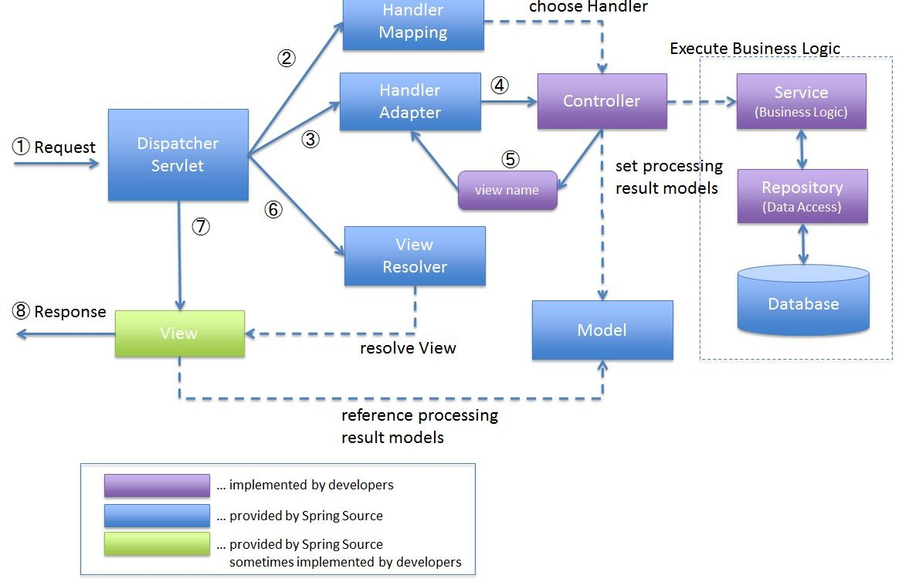
Request Processing Workflow (Details Level)
DispatcherServlet receives the request.
DispatcherServlet dispatches the task of selecting an appropriate controller to HandlerMapping. HandlerMapping selects the Controller which is mapped to the incoming request URL and returns the (selected Handler) and Controller to DispatcherServlet.
DispatcherServlet dispatches the task of executing of business logic of Controller to HandlerAdapter.
HandlerAdapter calls the business logic process of Controller.
Controller executes the business logic, sets the processing result in Model and returns the logical name of view to HandlerAdapter.
DispatcherServlet dispatches the task of resolving the View corresponding to the View name to ViewResolver. ViewResolver returns the View mapped to View name.
DispatcherServlet dispatches the rendering process to returned View.
View renders Model data and returns the response.

Slide 18
Web Application Context

Slide 19
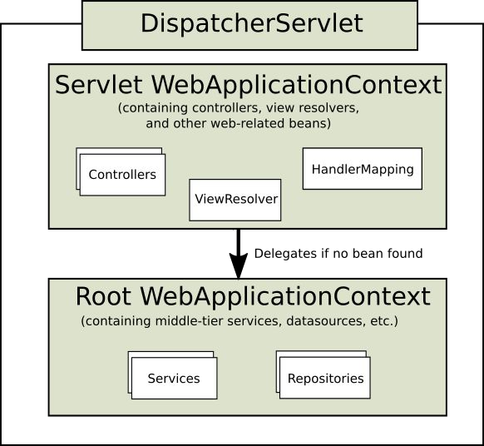
Web Application Context
DispatcherServlet expects a WebApplicationContext, an extension of a plain ApplicationContext, for its own configuration.
WebApplicationContext has a link to the
ServletContext and Servlet it is associated with.
The root WebApplicationContext typically contains infrastructure beans such as data repositories and business services which are inherited and could be overridden in the Servlet WebApplicationContext.
Servlet WebApplicationContext contains web-related beans: such as controllers, handler mappings,...

Slide 20
Spring MVC Configurations

Slide 21
Spring MVC Configurations
Spring MVC supports 2 type of configurations:
XML Configuration
Java-based Configuration

Slide 22
Important annotations

Slide 23
Important annotations
Some important annotations which are used in a Spring MVC application.
@Controller and @RestController
@RequestMapping
@GetMapping, @PostMapping, @PutMapping and @DeleteMapping
@RequestParam, @PathVariable
@RequestBody
@ResponseBody

Slide 24
Summary

